Slide 1

React getting started
„Dieses andere Framework“

Slide 2

tTobias Struckmeier
Tobias Struckmeier
PHP
v.39
Javascript
Fullstack since 1999
Mysql, couchdb, cordova, ionic linux, windows, mac, …
Design & UX inside
Alles andere beim Getränk danach

Slide 3

Schönes Büros

Slide 4

Cooles “Spielzeug“

Slide 5
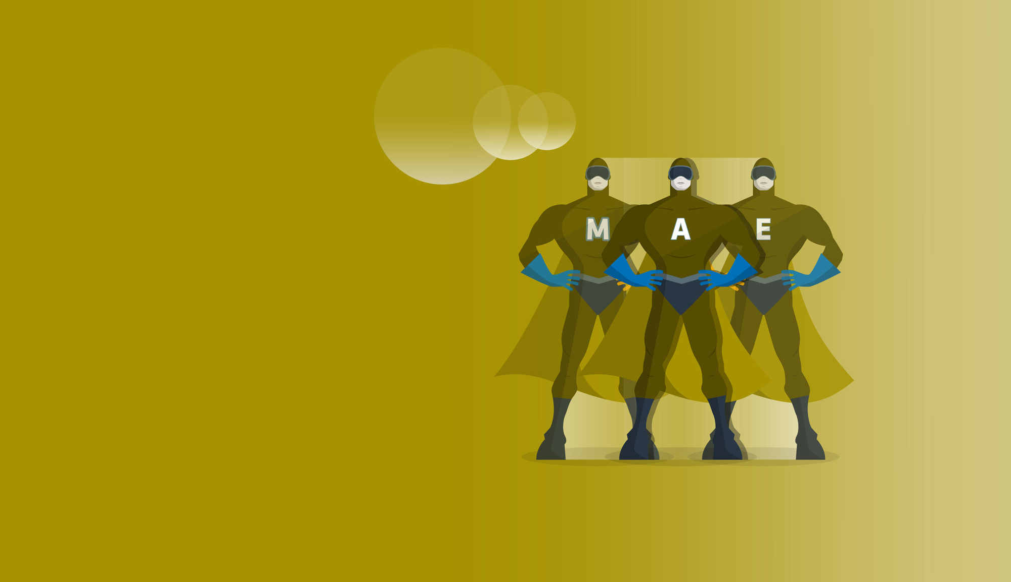
Wir suchen Helden nette Kollegen
Nein? Doch! Ooooh!

Slide 6
No framework
But people always say that?!?
You did too!

Slide 7
Component library & concepts
There are a couple of concepts in the react „world“
&
An ecosystem of components and libraries that work together. Based on those concepts
React basically is just a view
(pun intended)

Slide 8
React ecosystem
Angular
DIY
Comes opinionated
and preassembled

Slide 9
Unidirectional Data Flow (Flux)
Action
Dispatcher
Store
View
Single Source
Of Truth
Renders everytime the state changes
render()

Slide 10

Virtual DOM
Virtual DOM (Memory)
Server Side Rendering FTW!
componentWillReceiveProps()
componentWillUpdate()
Reconciler does
Patchset
Smart diff
Real DOM (Browser)
Can also be something else
WebGL
Smartphone App
AFrame
PDF
Sketch/Photoshop
Smarthome
Canvas
Apply to DOM
Sound

Slide 11
Presentational Components Container Components
Just rendering the state it gets
Propagates events to parent
Combines presentational components to a bigger concept
Handles complex logic, dispatches actions,
a bit dataflow, lifecycle optimizations

Slide 12
Minimal react app
Myapp.js
var MyApp = React.createClass({
render: function() {
return React.createElement("h1", null, `Hello ${this.props.toWhom}`);
}
})
ReactDOM.render(
React.createElement(MyApp, {toWhom: 'NgNiederhein'}, null),
document.getElementById('root')
);
Somewhere in an index.html not so far away:
<html><head>
<script src="https://unpkg.com/react@15/dist/react.js"></script>
<script src="https://unpkg.com/react-dom@15/dist/react-dom.js"></script> <script src=“Myapp.js"></script>
</head><body>
<div id="root" />
</body></html>

Slide 13

Minimal react app
Myapp.js
var MyApp = React.createClass({
render: function() {
return React.createElement("h1", null, `Hello ${this.props.toWhom}`);
}
})
ReactDOM.render(
React.createElement(MyApp, {toWhom: 'NgNiederhein'}, null),
document.getElementById('root')
);
WAIT!!!!
It looks so different in all those tutorials online!
Somewhere in an index.html not so far away:
<html><head>
<script src="https://unpkg.com/react@15/dist/react.js"></script>
<script src="https://unpkg.com/react-dom@15/dist/react-dom.js"></script> <script src=“Myapp.js"></script>
</head><body>
<div id="root" />
</body></html>

Slide 14


JSX
Myapp.jsx
Import React, { Component } from "react";
class MyApp extends Component {
render() {
return (<h1>Hello {this.props.toWhom}</h1>);
}
}
ReactDOM.render(<MyApp toWhom="NgNiederhein" />, document.getElementById('root'));
Isn‘t that like PHP in it‘s early days?
Yes, kinda. Hey it‘s a view!
And its rendering logic. Expressed in JS
But it‘s not messy. I promise.

Slide 15

Booooooring!
Show me some code

